Slide 1
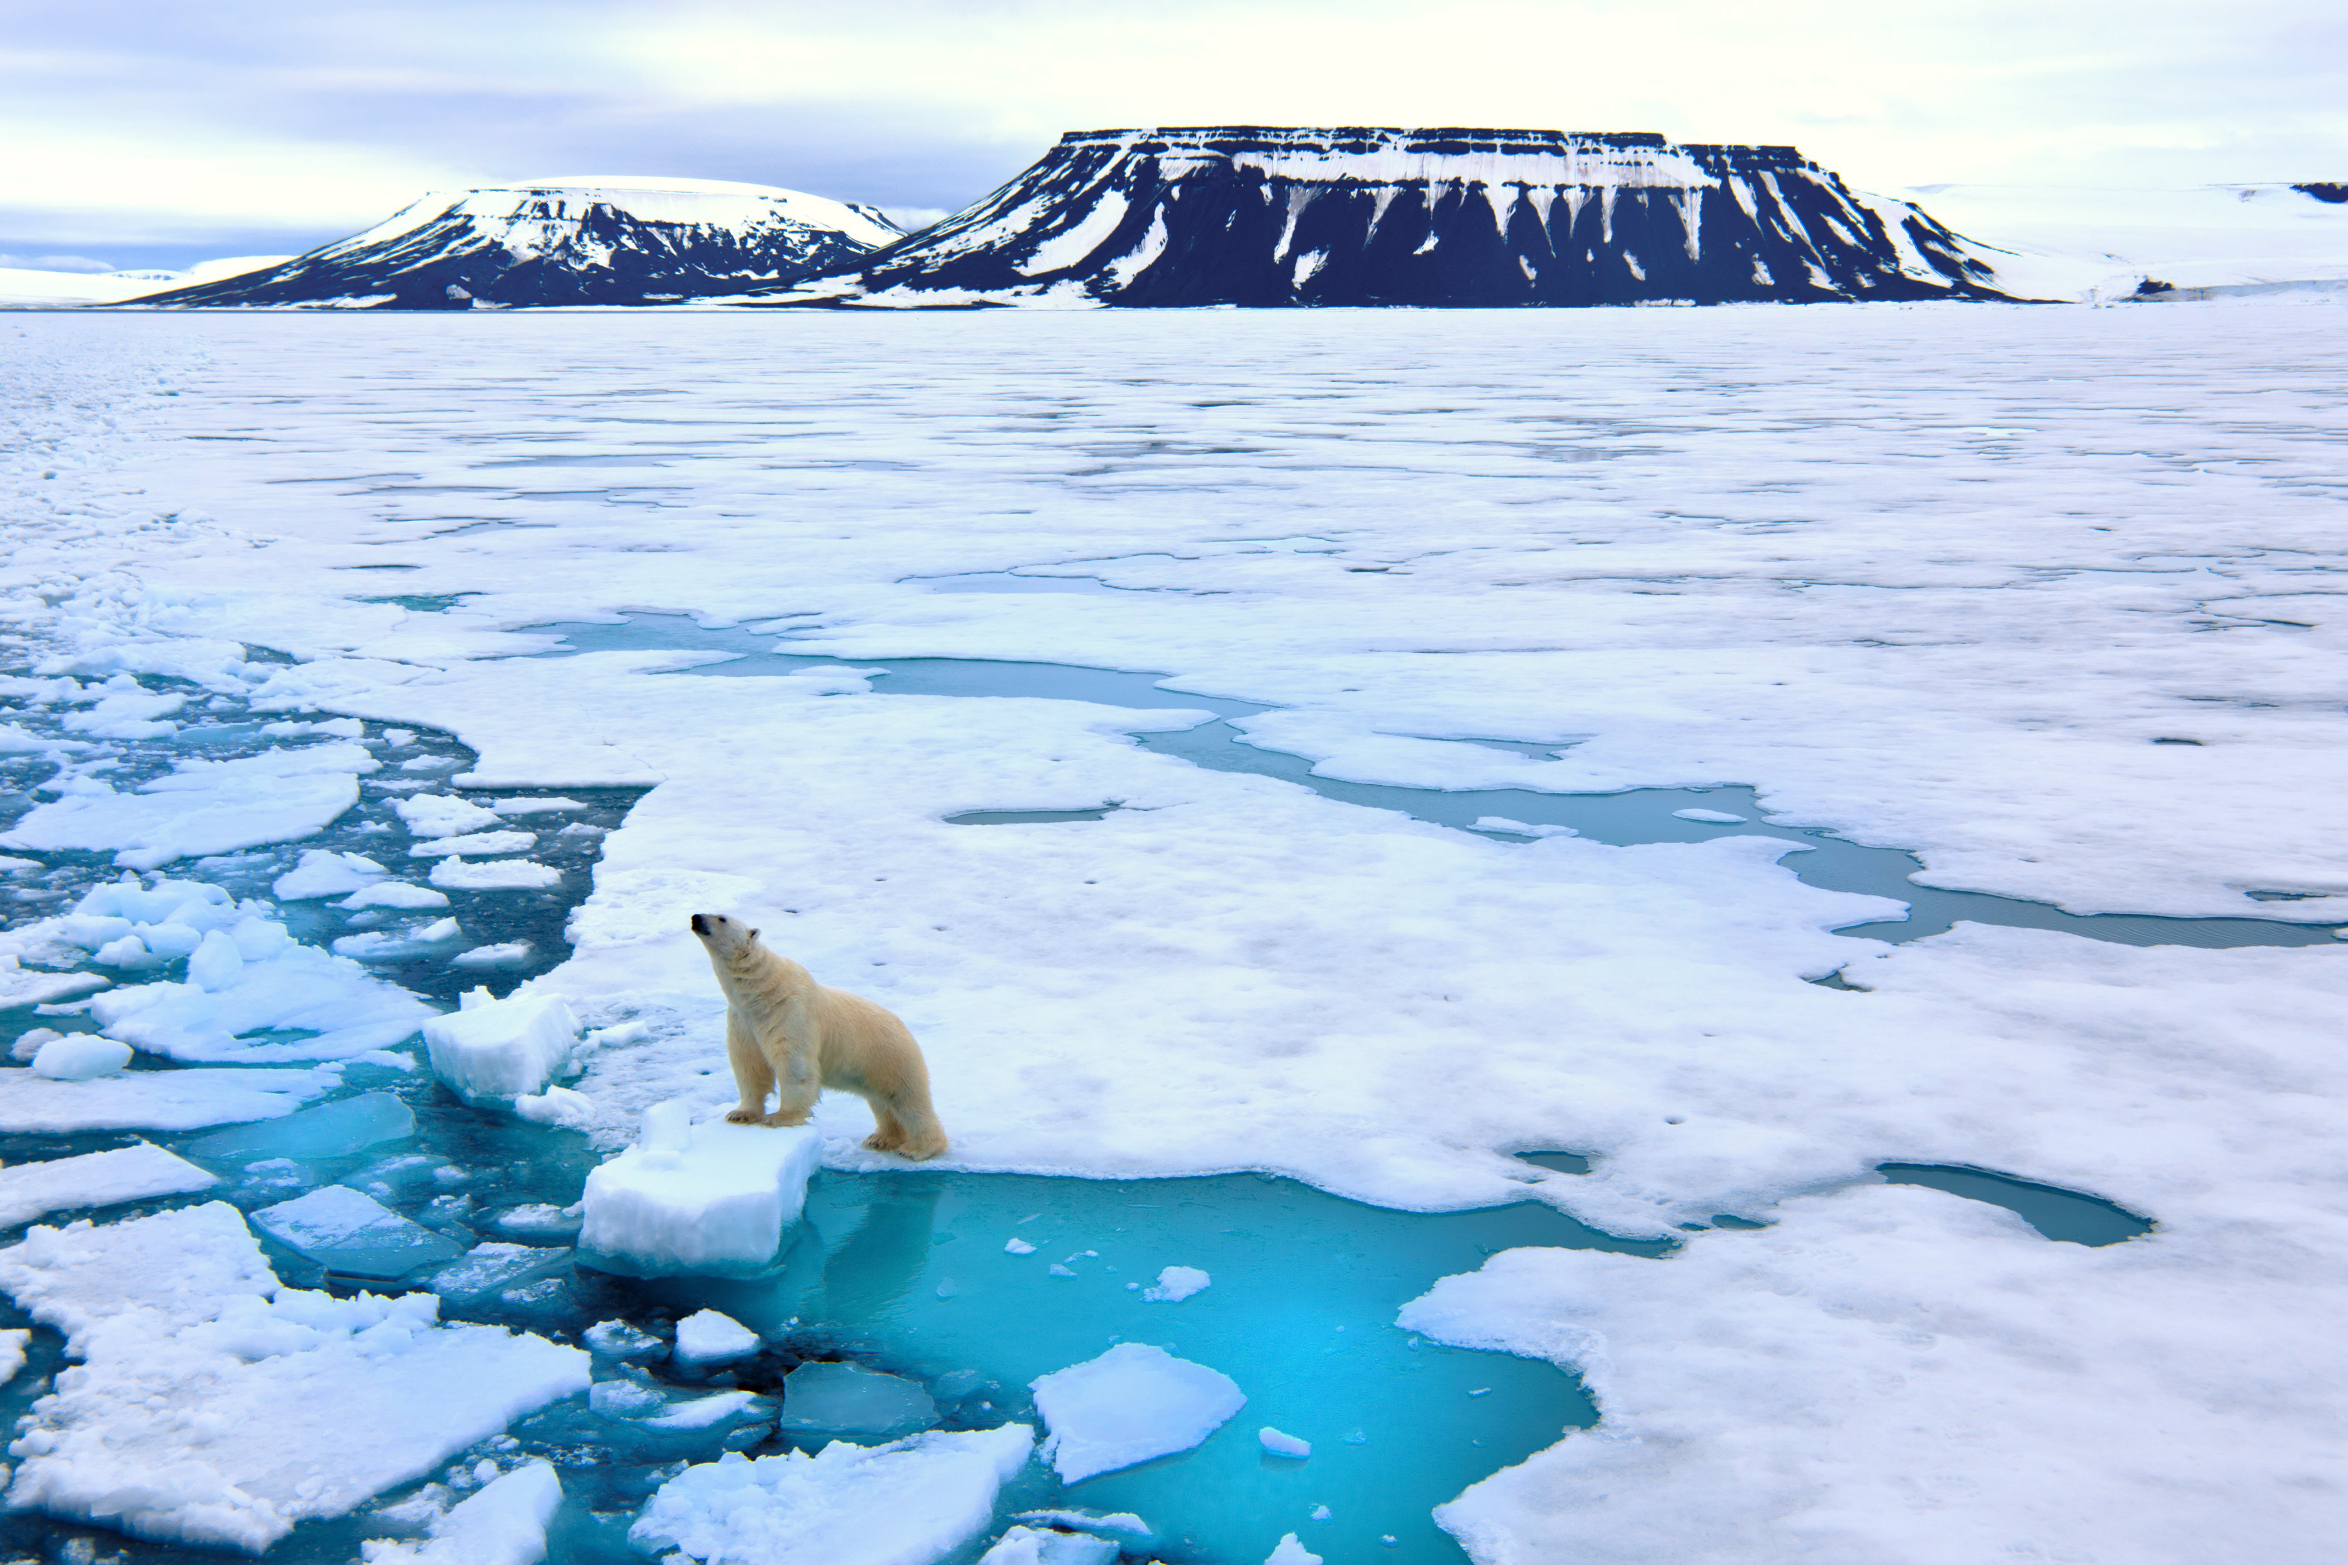
Final Project
Annie DeRossi
Drew Henning
Moe Taherian
Ronnie Canepa
Zaira Coronado

Slide 2
Global Warming: Continued
Final Project is a continuation of theme from Project 2.
Used Machine Learning and plethora of other tools to ask the question how global warming will impact average temperatures and rising sea levels at Fort Pulaski, GA and San Diego, CA within the next 10 years.
Focused on Fort Pulaski and San Diego because it had the most complete data and wanted to have a well-rounded analysis from the east coast and west coast.
Both Fort Pulaski and San Diego data from1979 to 2021and forecasted up to 2031.

Slide 3
Machine Learning Content Used
Since the data we used is in a time series, we needed to find a Machine Learning tool that would work best with it.
Facebook Prophet is a tool for forecasting time series data where non-linear trends are fit with yearly, weekly and daily seasonality.
Prophet worked best for our data because it showed a strong seasonal effect of historical data since average temperatures and sea levels rise and fall with changing weather conditions throughout the year.

Slide 4
Additional Tools Used
Google Colab
Pandas
Matplotlib
HTML/CSS/Bootstrap
Plotly
FbProphet
D3.js

Slide 5
Host Application Used
Host application using Heroku or a tool of your choice – TBD (streamlit)

Slide 6
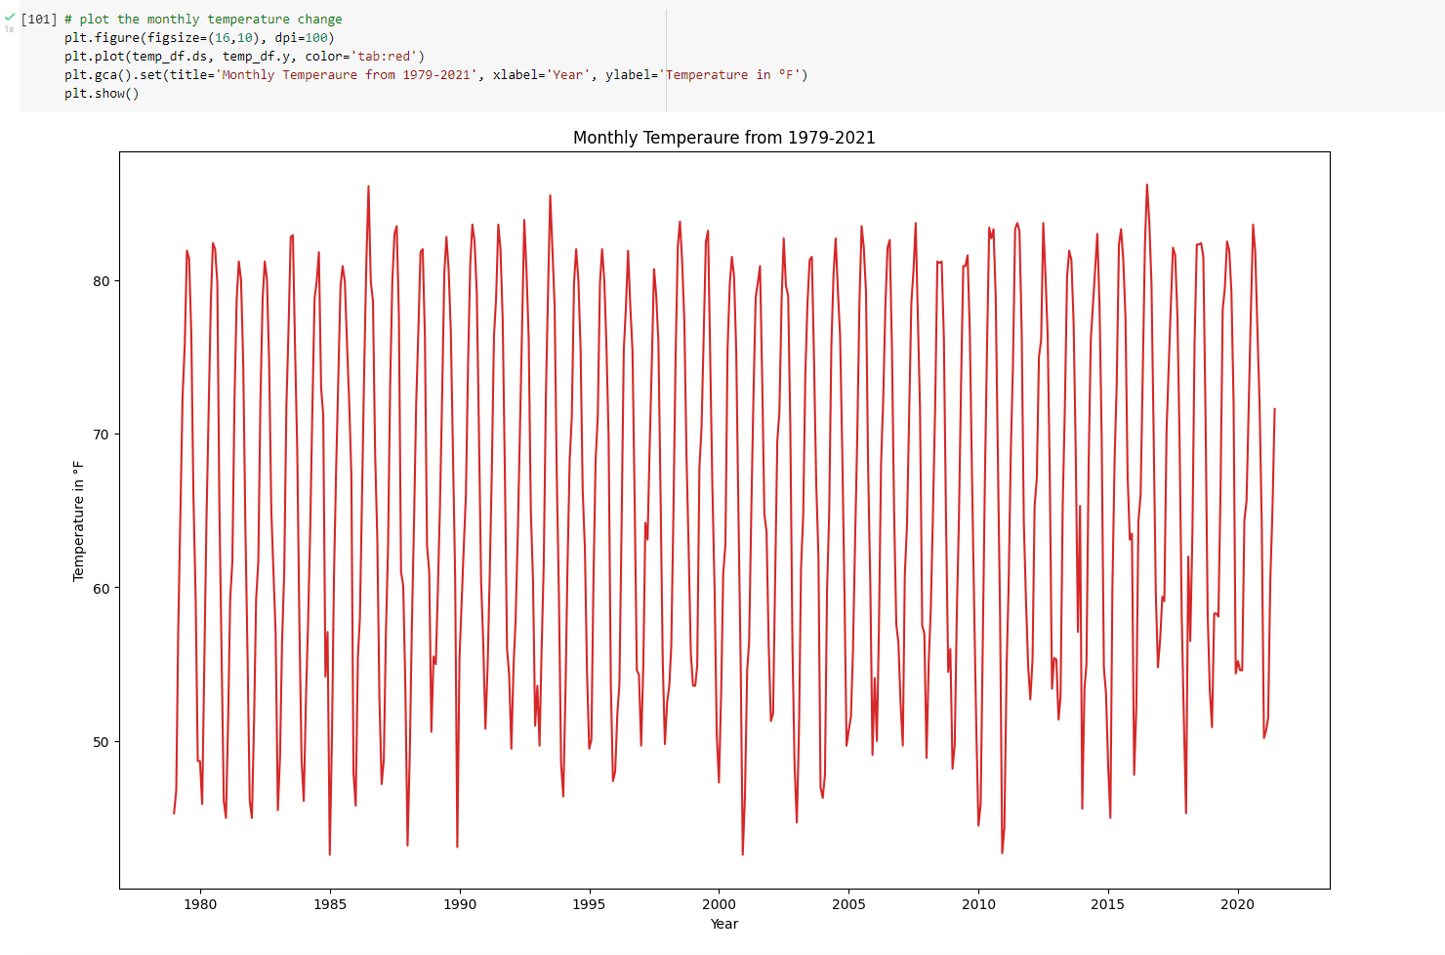
Walkthrough
Google Colab notebook starts with your typical boilerplate code by importing dependencies (pandas, fbprophet and matplotlib), reading the CSV and formatting/renaming columns
Once data was in the correct format, we used Matplotlib to chart monthly temperature from 1979-2021

Slide 7
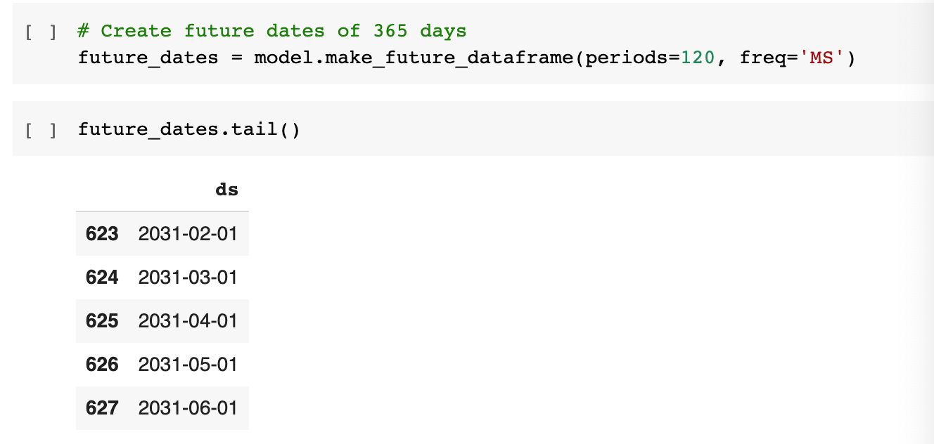
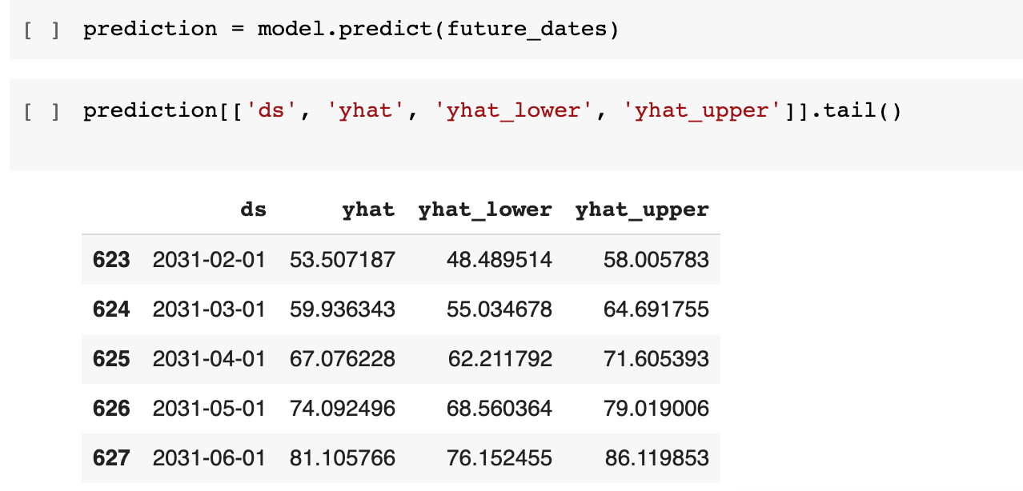
Walkthrough (cont.)
Now it is time to forecast our weather data to predict conditions for the next 10 years
Boilerplate code was imported from the documentation
Forecasting 10 years adds 120 months to the monthly temperatures chart
model.predict is used to generate predicted values (yhat) and ranges (yhat lower and yhat upper)

Slide 8
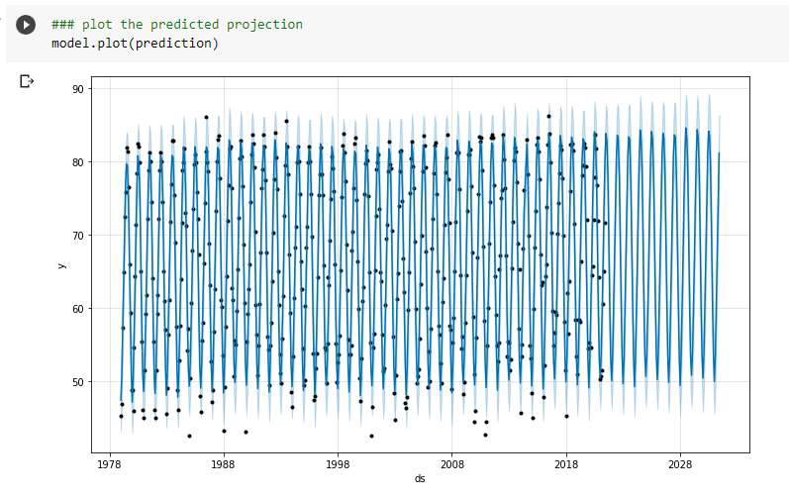
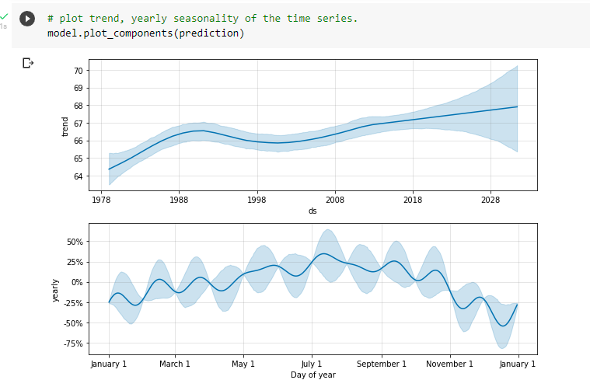
Walkthrough (cont.)
Prediction graph can now be plotted using the prediction model
Trend and yearly seasonality (respectively), are also plotted using the same method

Slide 9
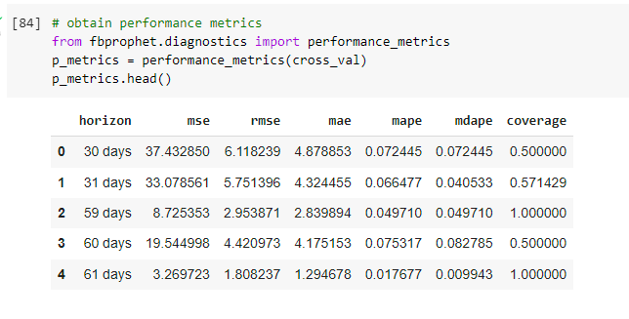
Walkthrough (cont.)
Performance metrics are generated to test how accurate the predictions are
RMSE scores vary, however, remain close to 1 which in weather forecasting is acceptable considering other factors that impact temperature (i.e. humidity, wind, etc.)

Slide 10
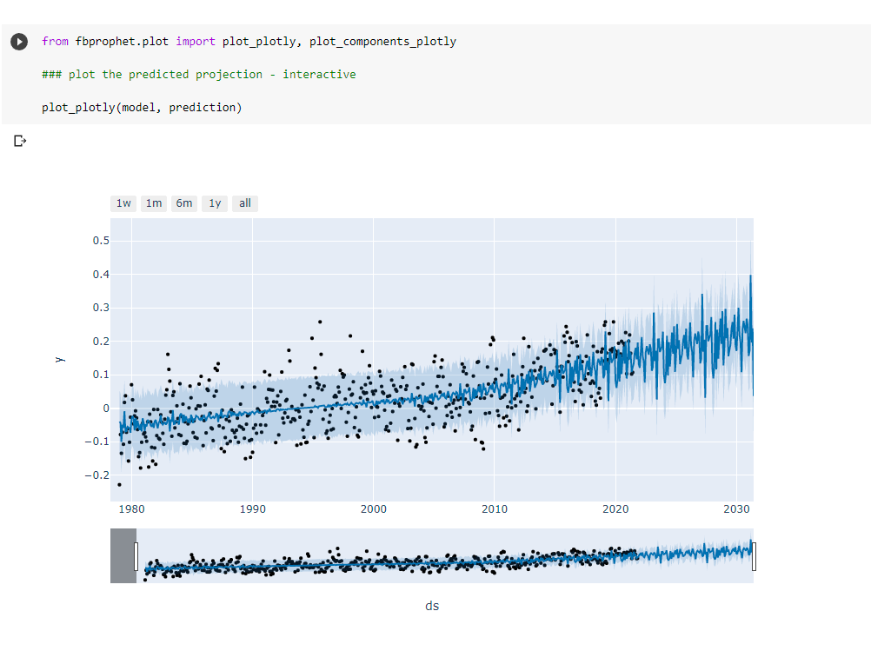
Walkthrough (cont.)
Similar methods were used for graphing and predicting sea levels
An interactive chart is used to zoom in closer to certain parts of future years to come

Slide 11
The End

